Slide 1

Team Members: Kodanda Rama Yaswanth Kumar Ramadugu (KXR230001) Uday Teja Bandaru (UTB220000)
VLSI DESIGN (CE 6325)
4- Bit Microprocessor

Slide 2
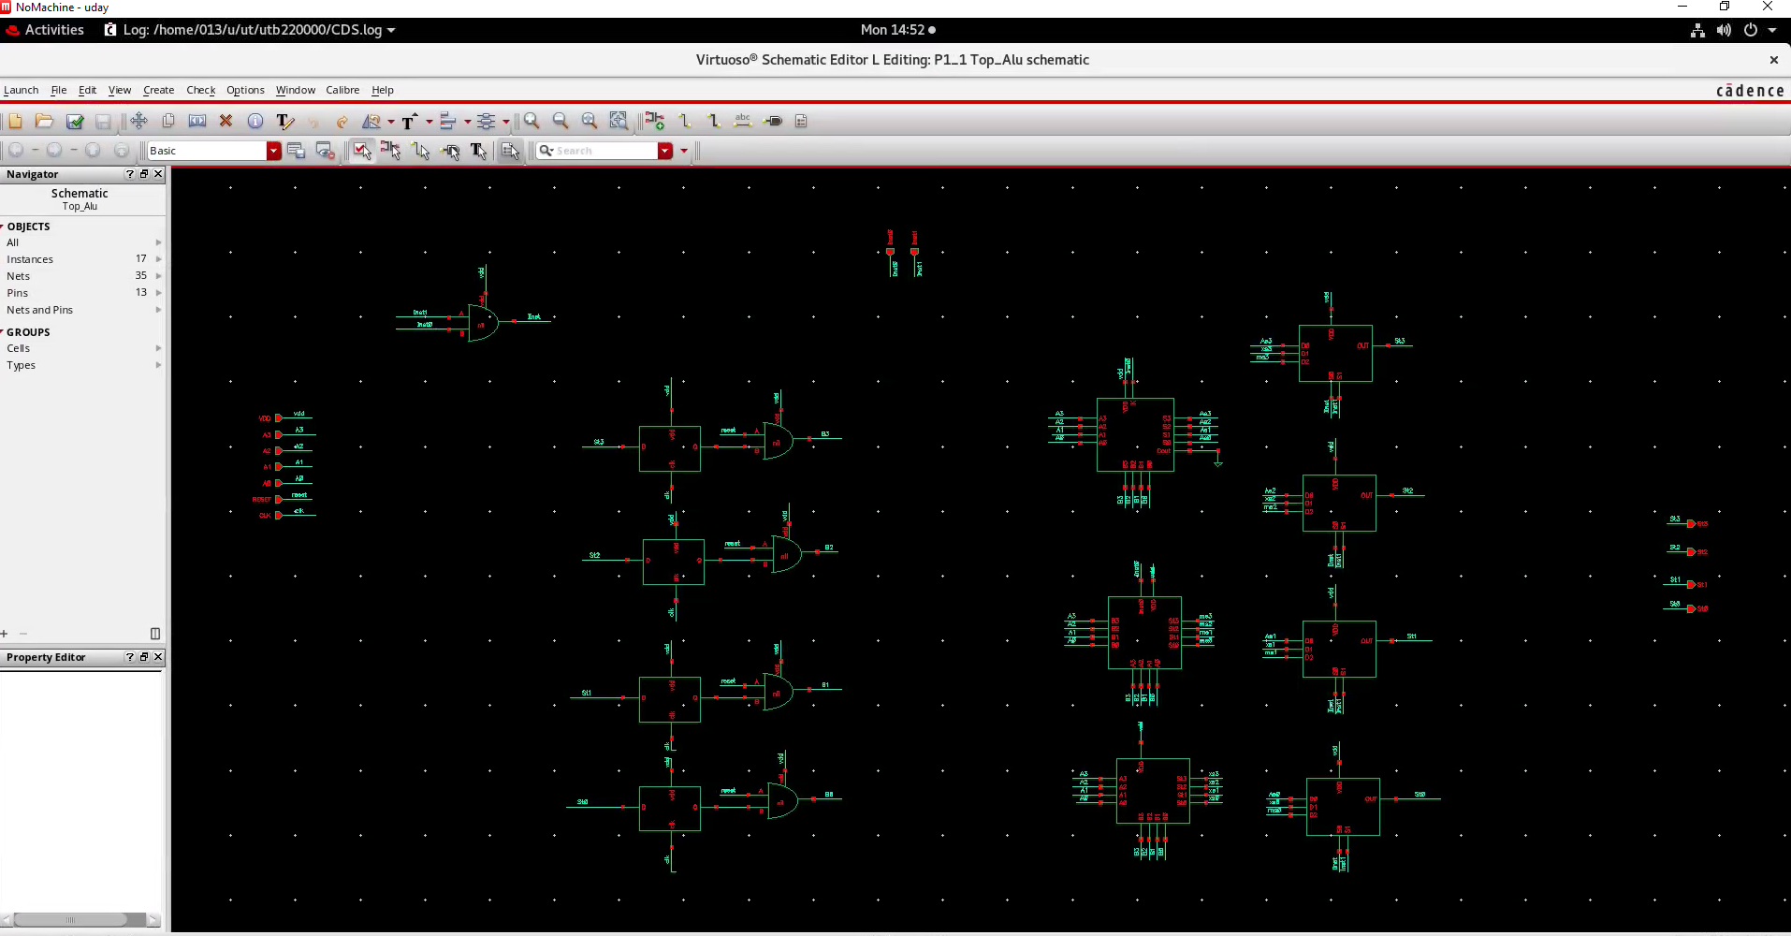
Initial Schematic:

Slide 3
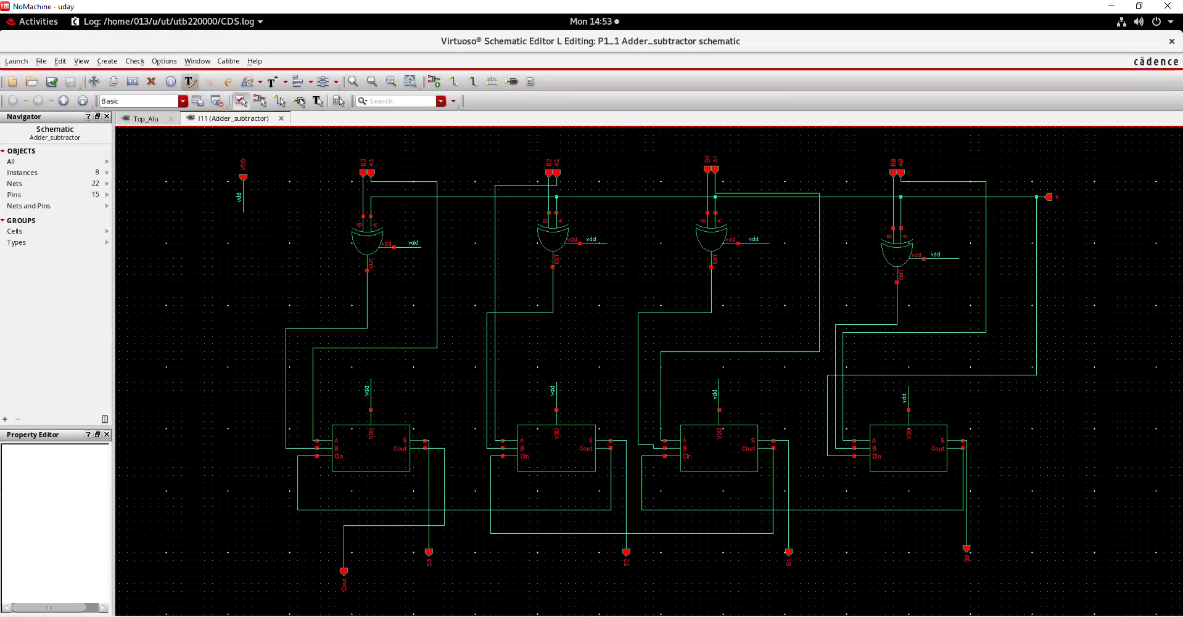
Add/Sub Block

Slide 4
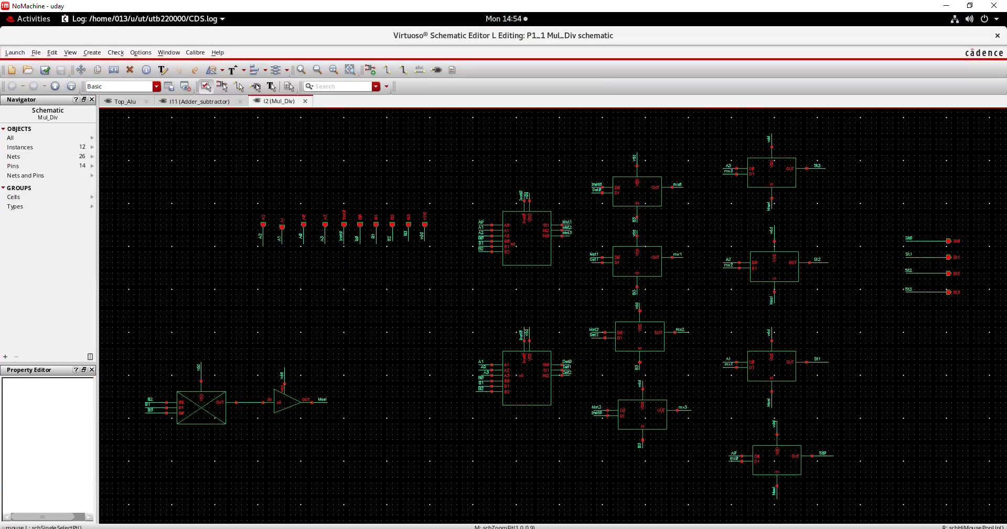
Mul/ Div Block

Slide 5
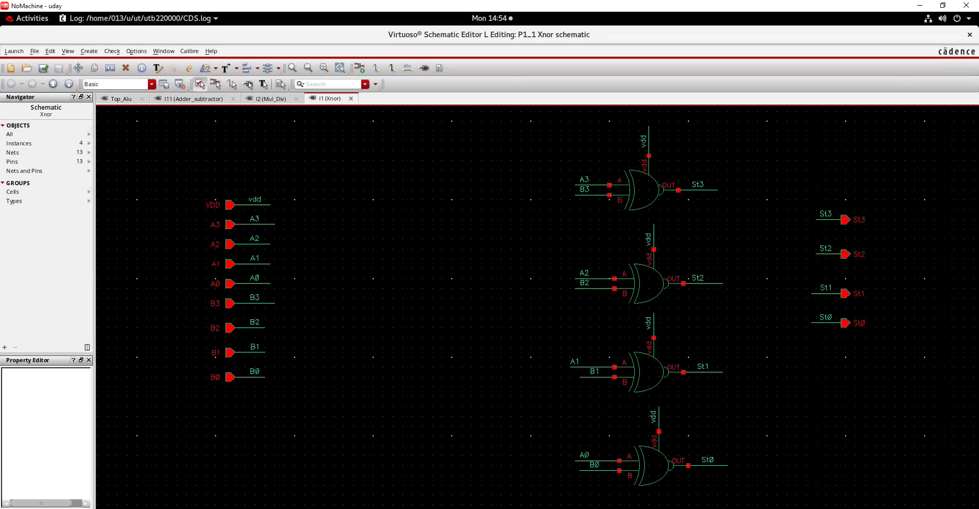
XNOR Block

Slide 6
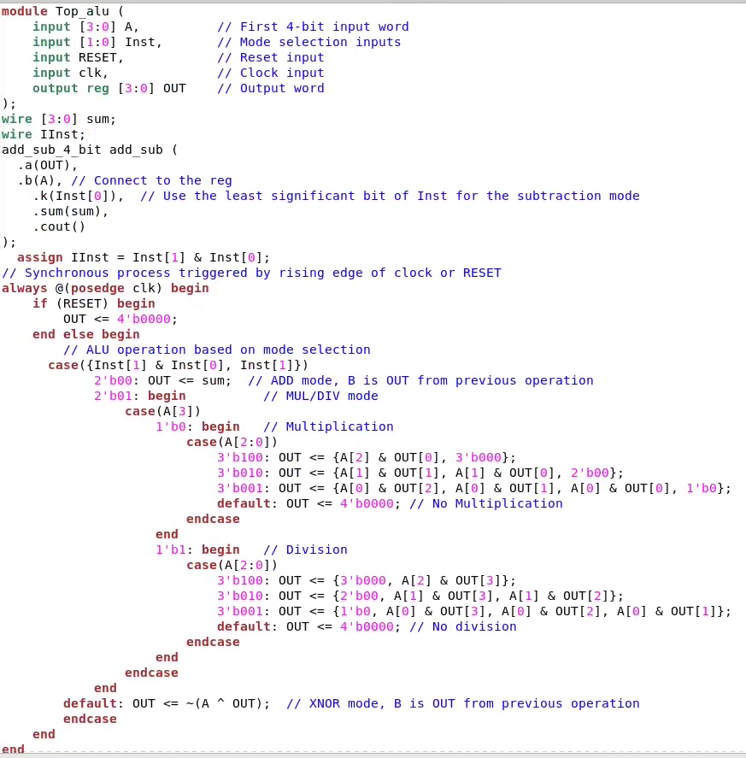
Verilog Code:

Slide 7
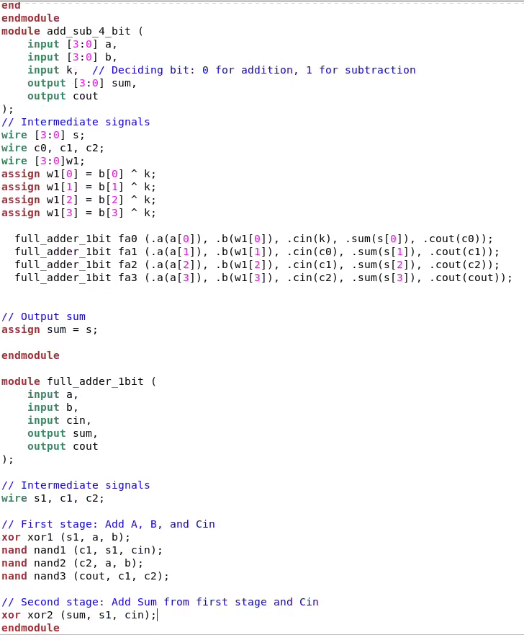

Slide 8
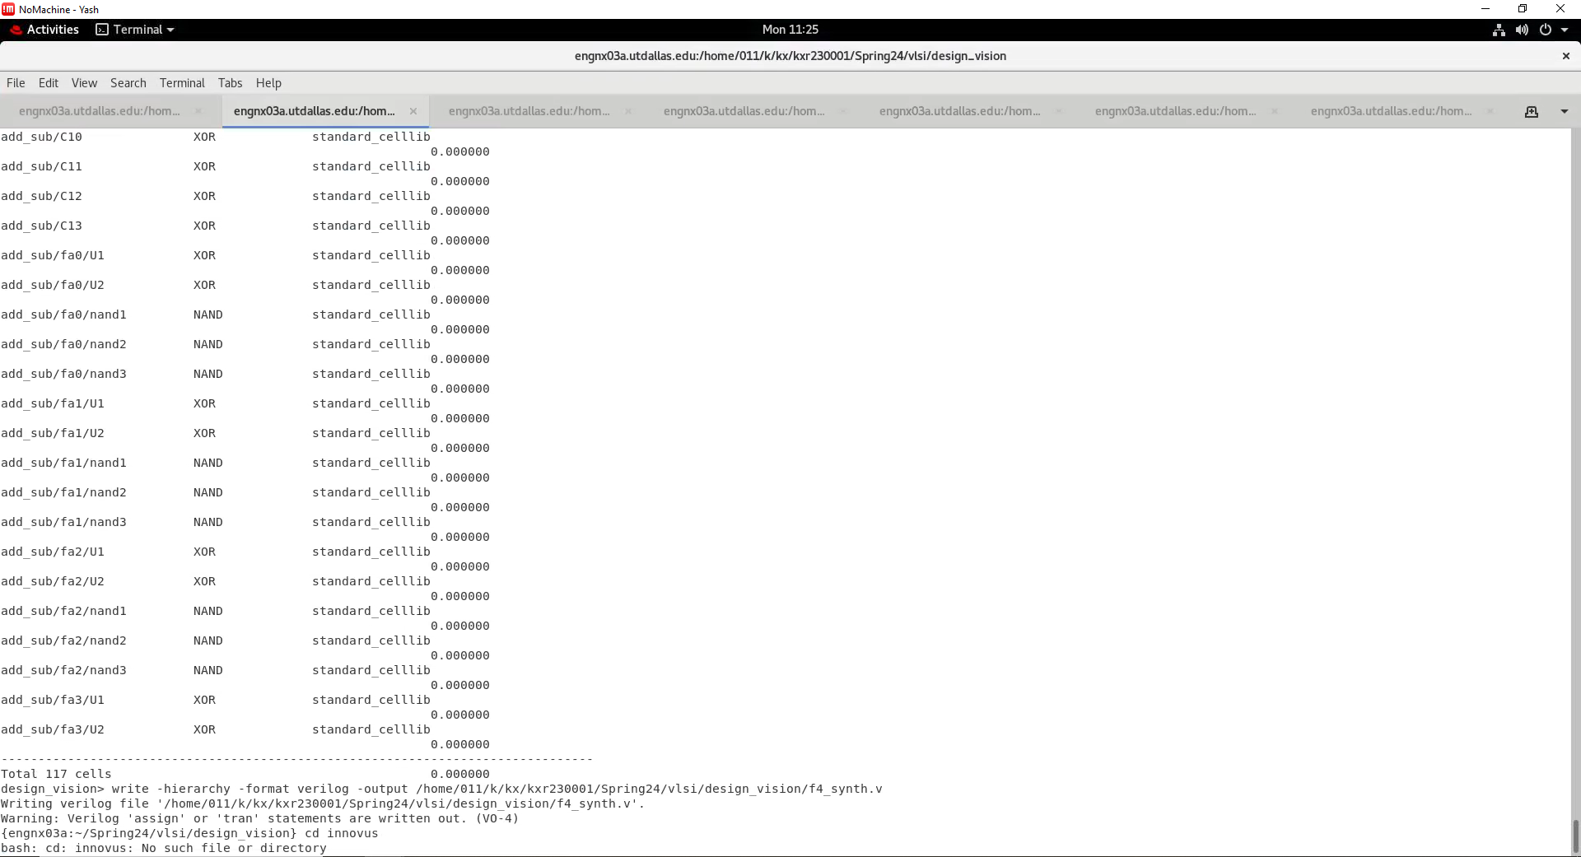
Design Vision

Slide 9
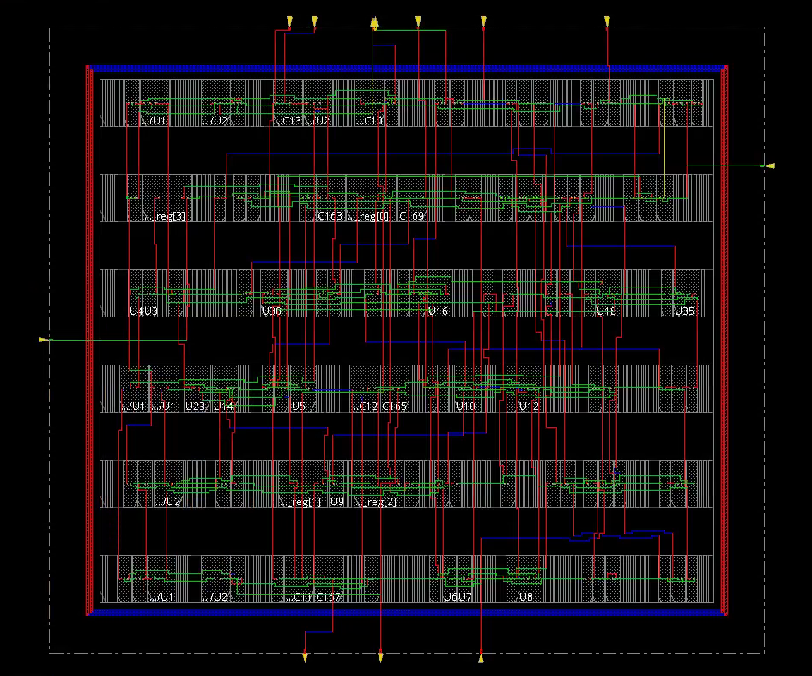
Innovus

Slide 10
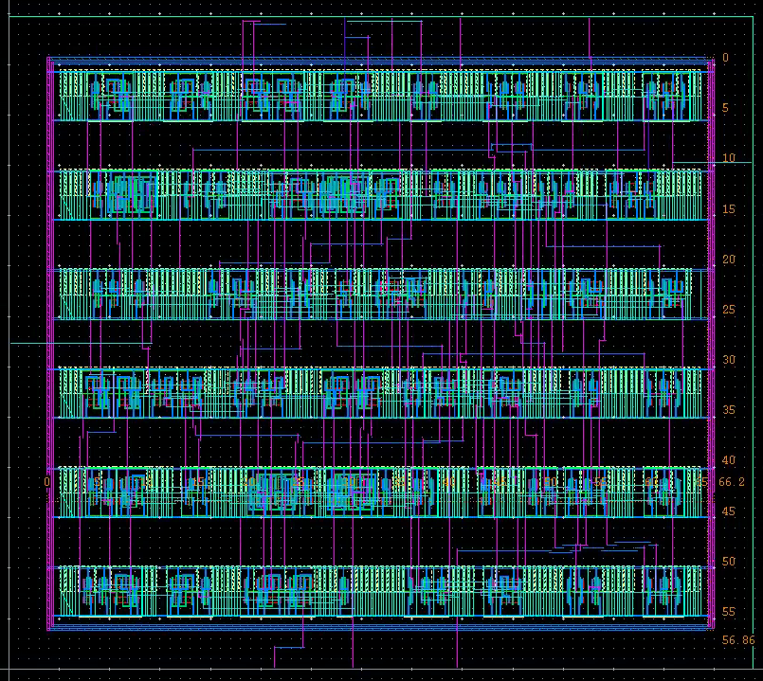
Layout

Slide 11
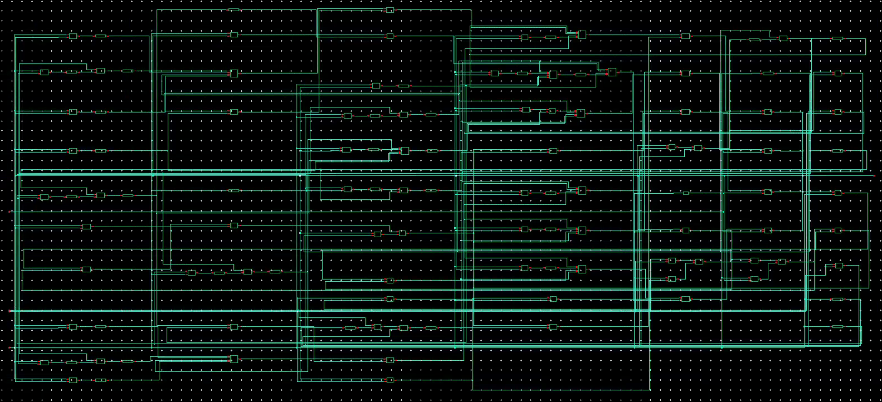
Schematic

Slide 12
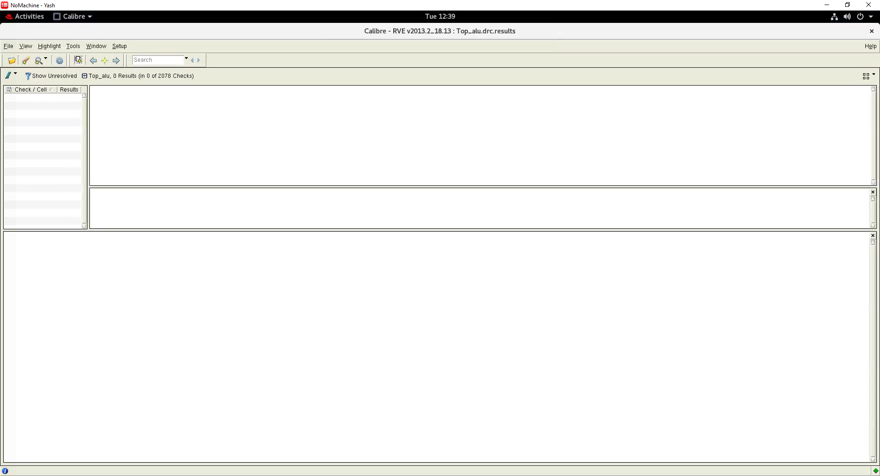
DRC

Slide 13
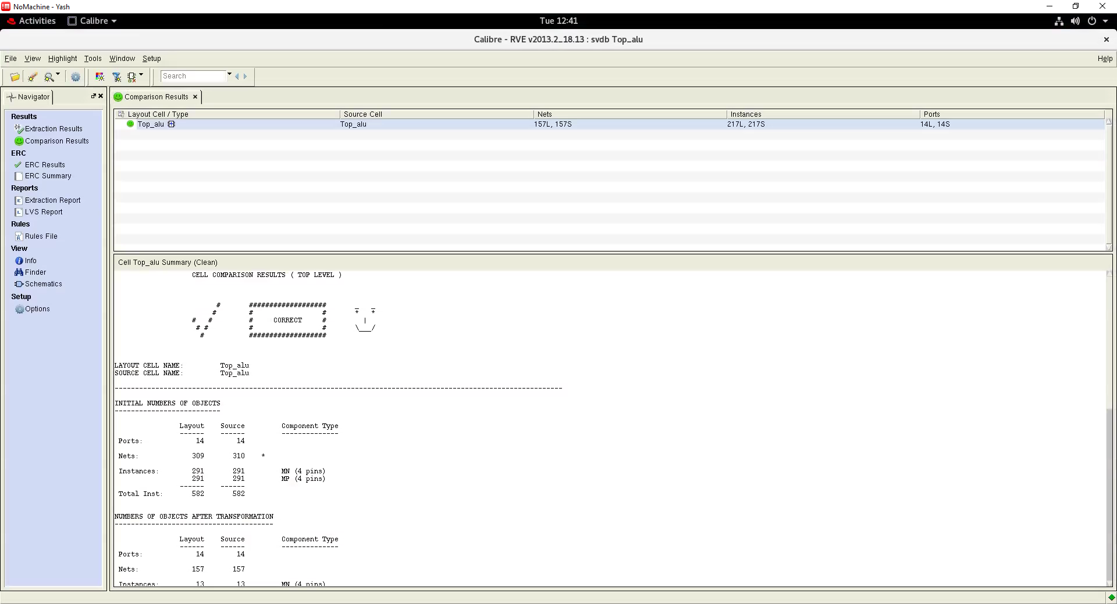
LVS

Slide 14
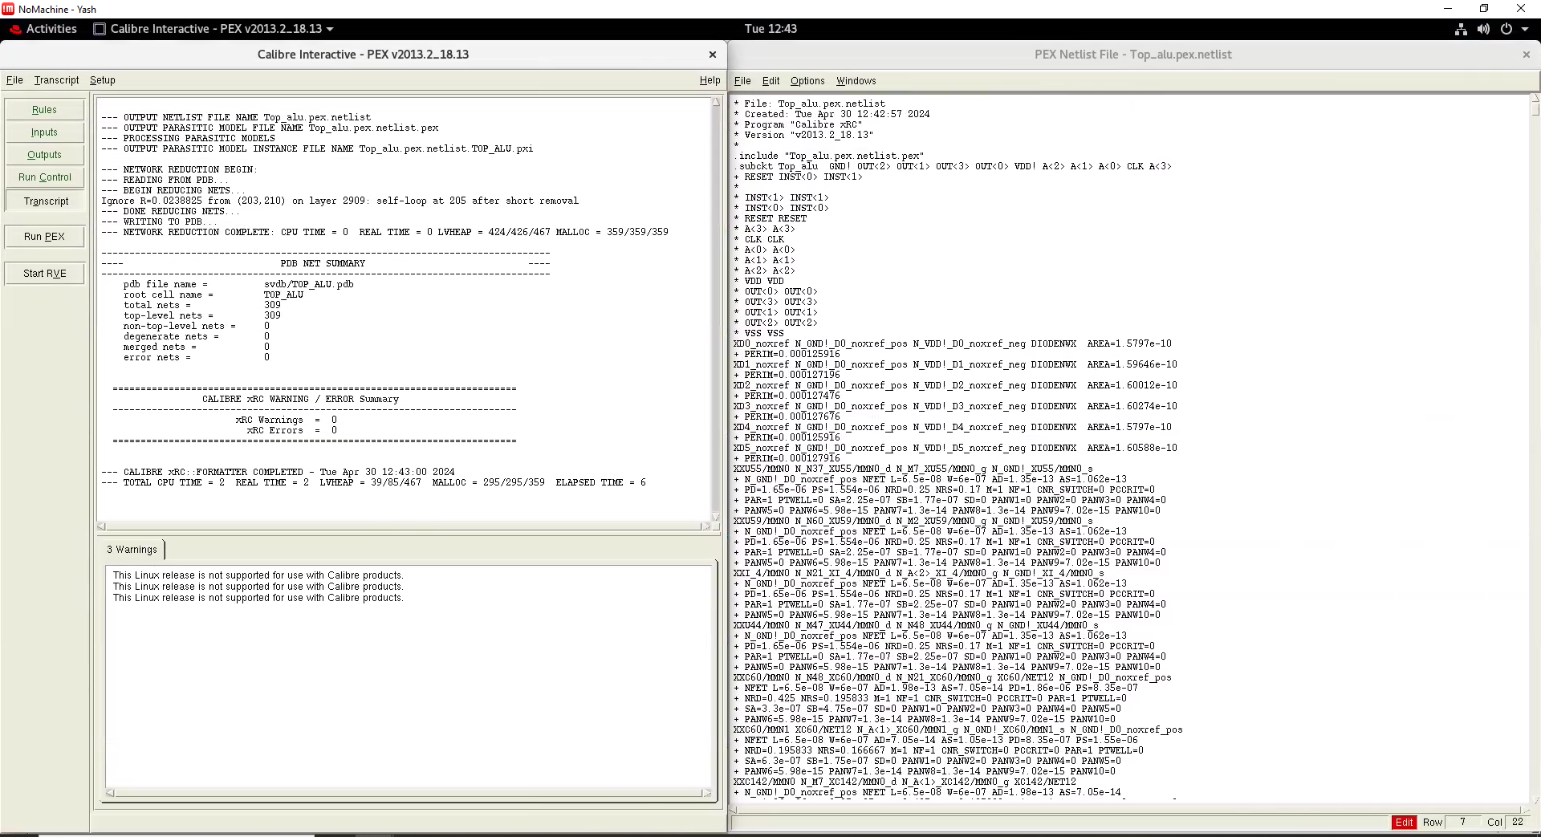
PEX

Slide 15
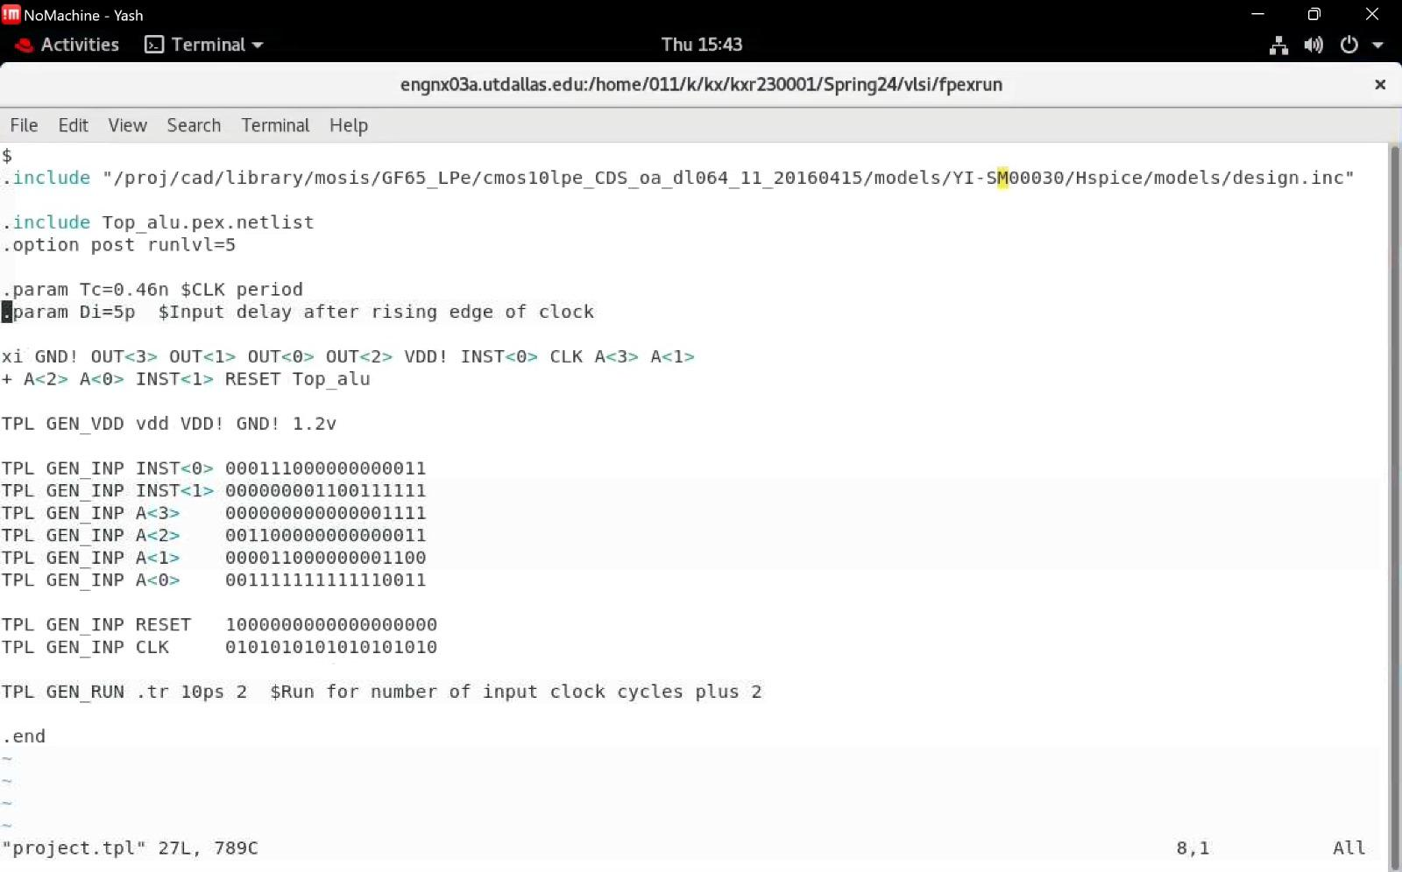
TPL File

Slide 16
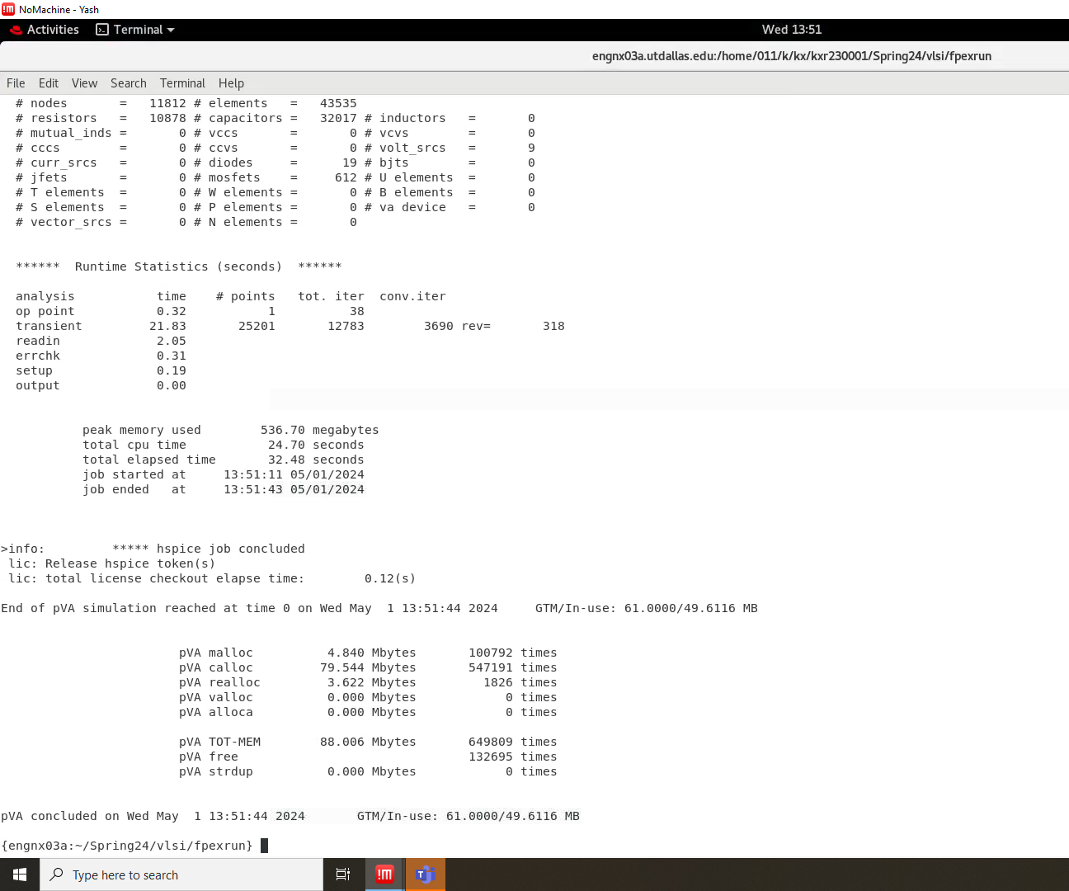
Hspice Terminal

Slide 17
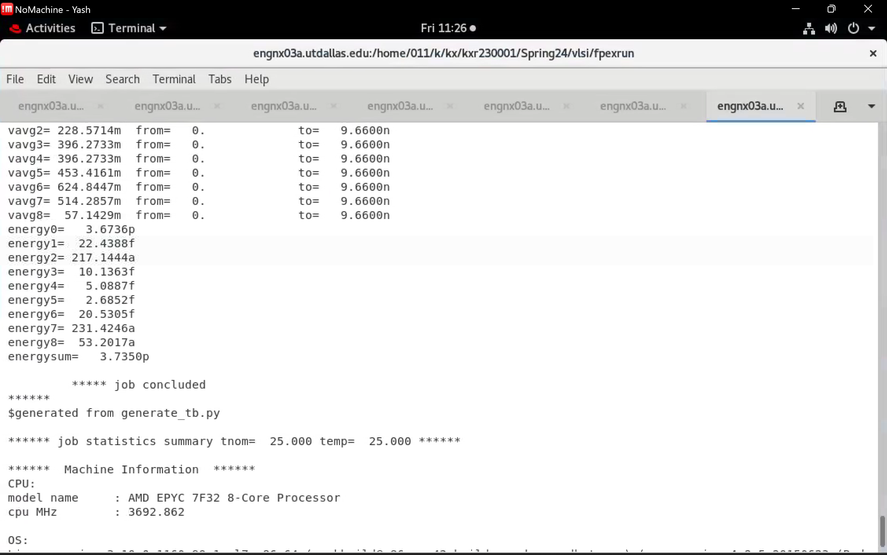
Energy values in Hspice terminal:

Slide 18
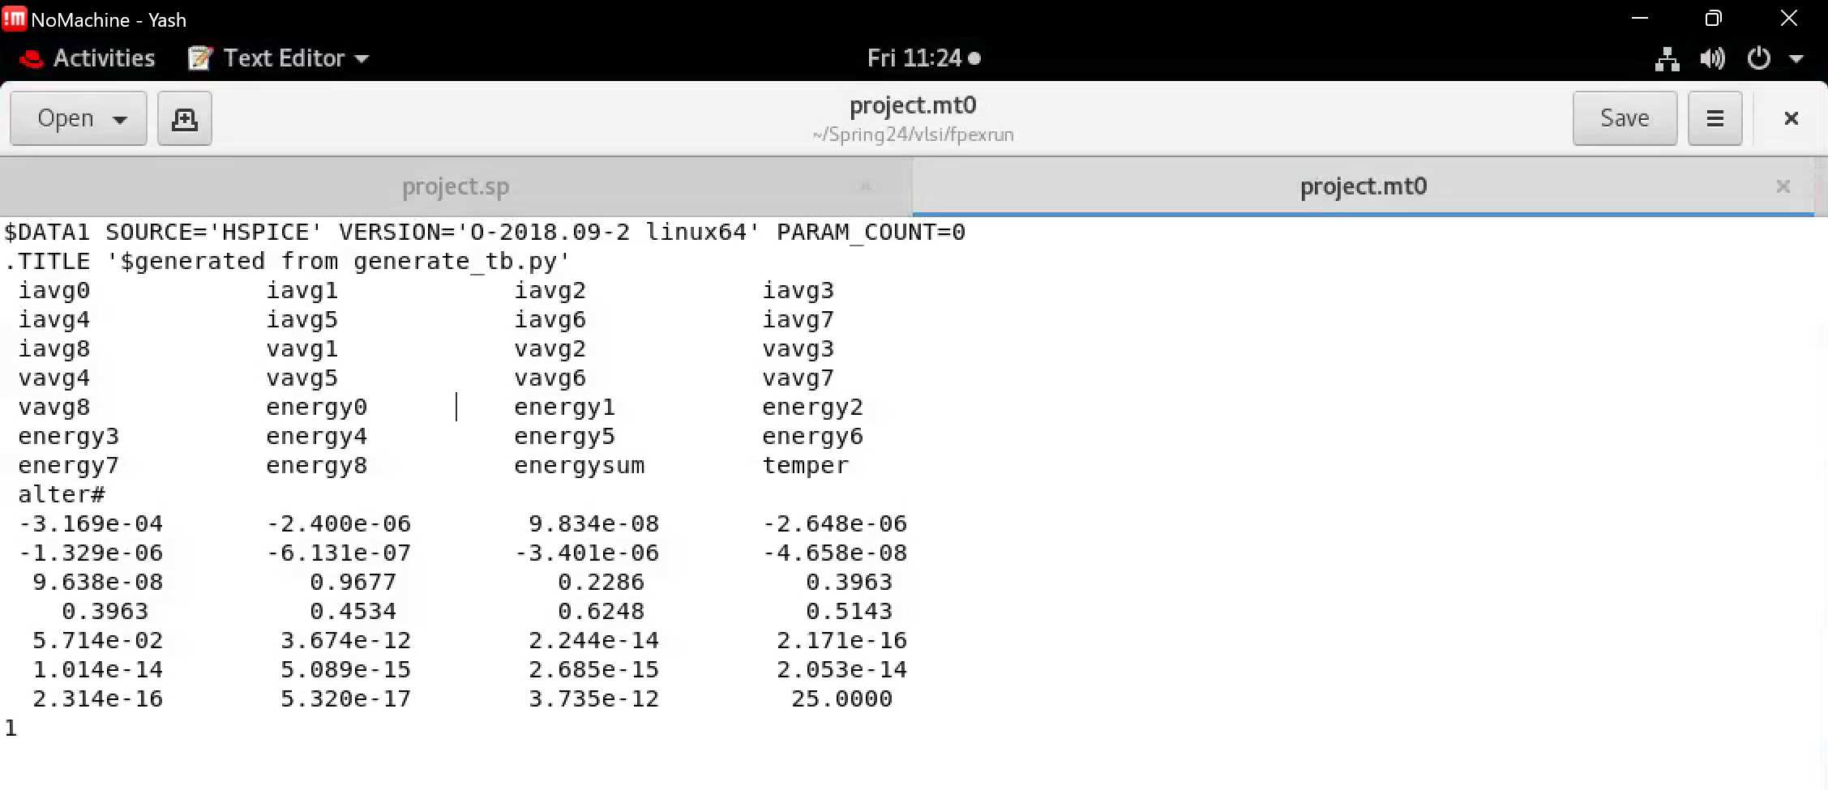
.mt0

Slide 19
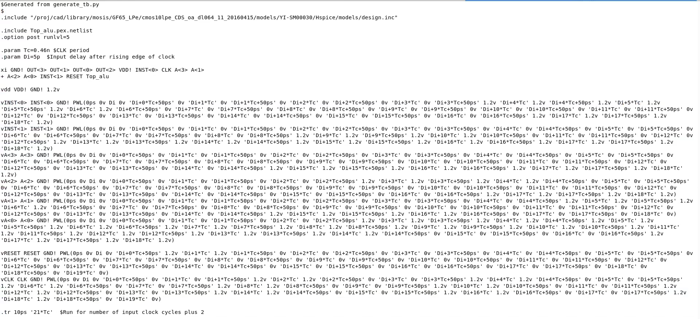
.sp (Setup File)

Slide 20
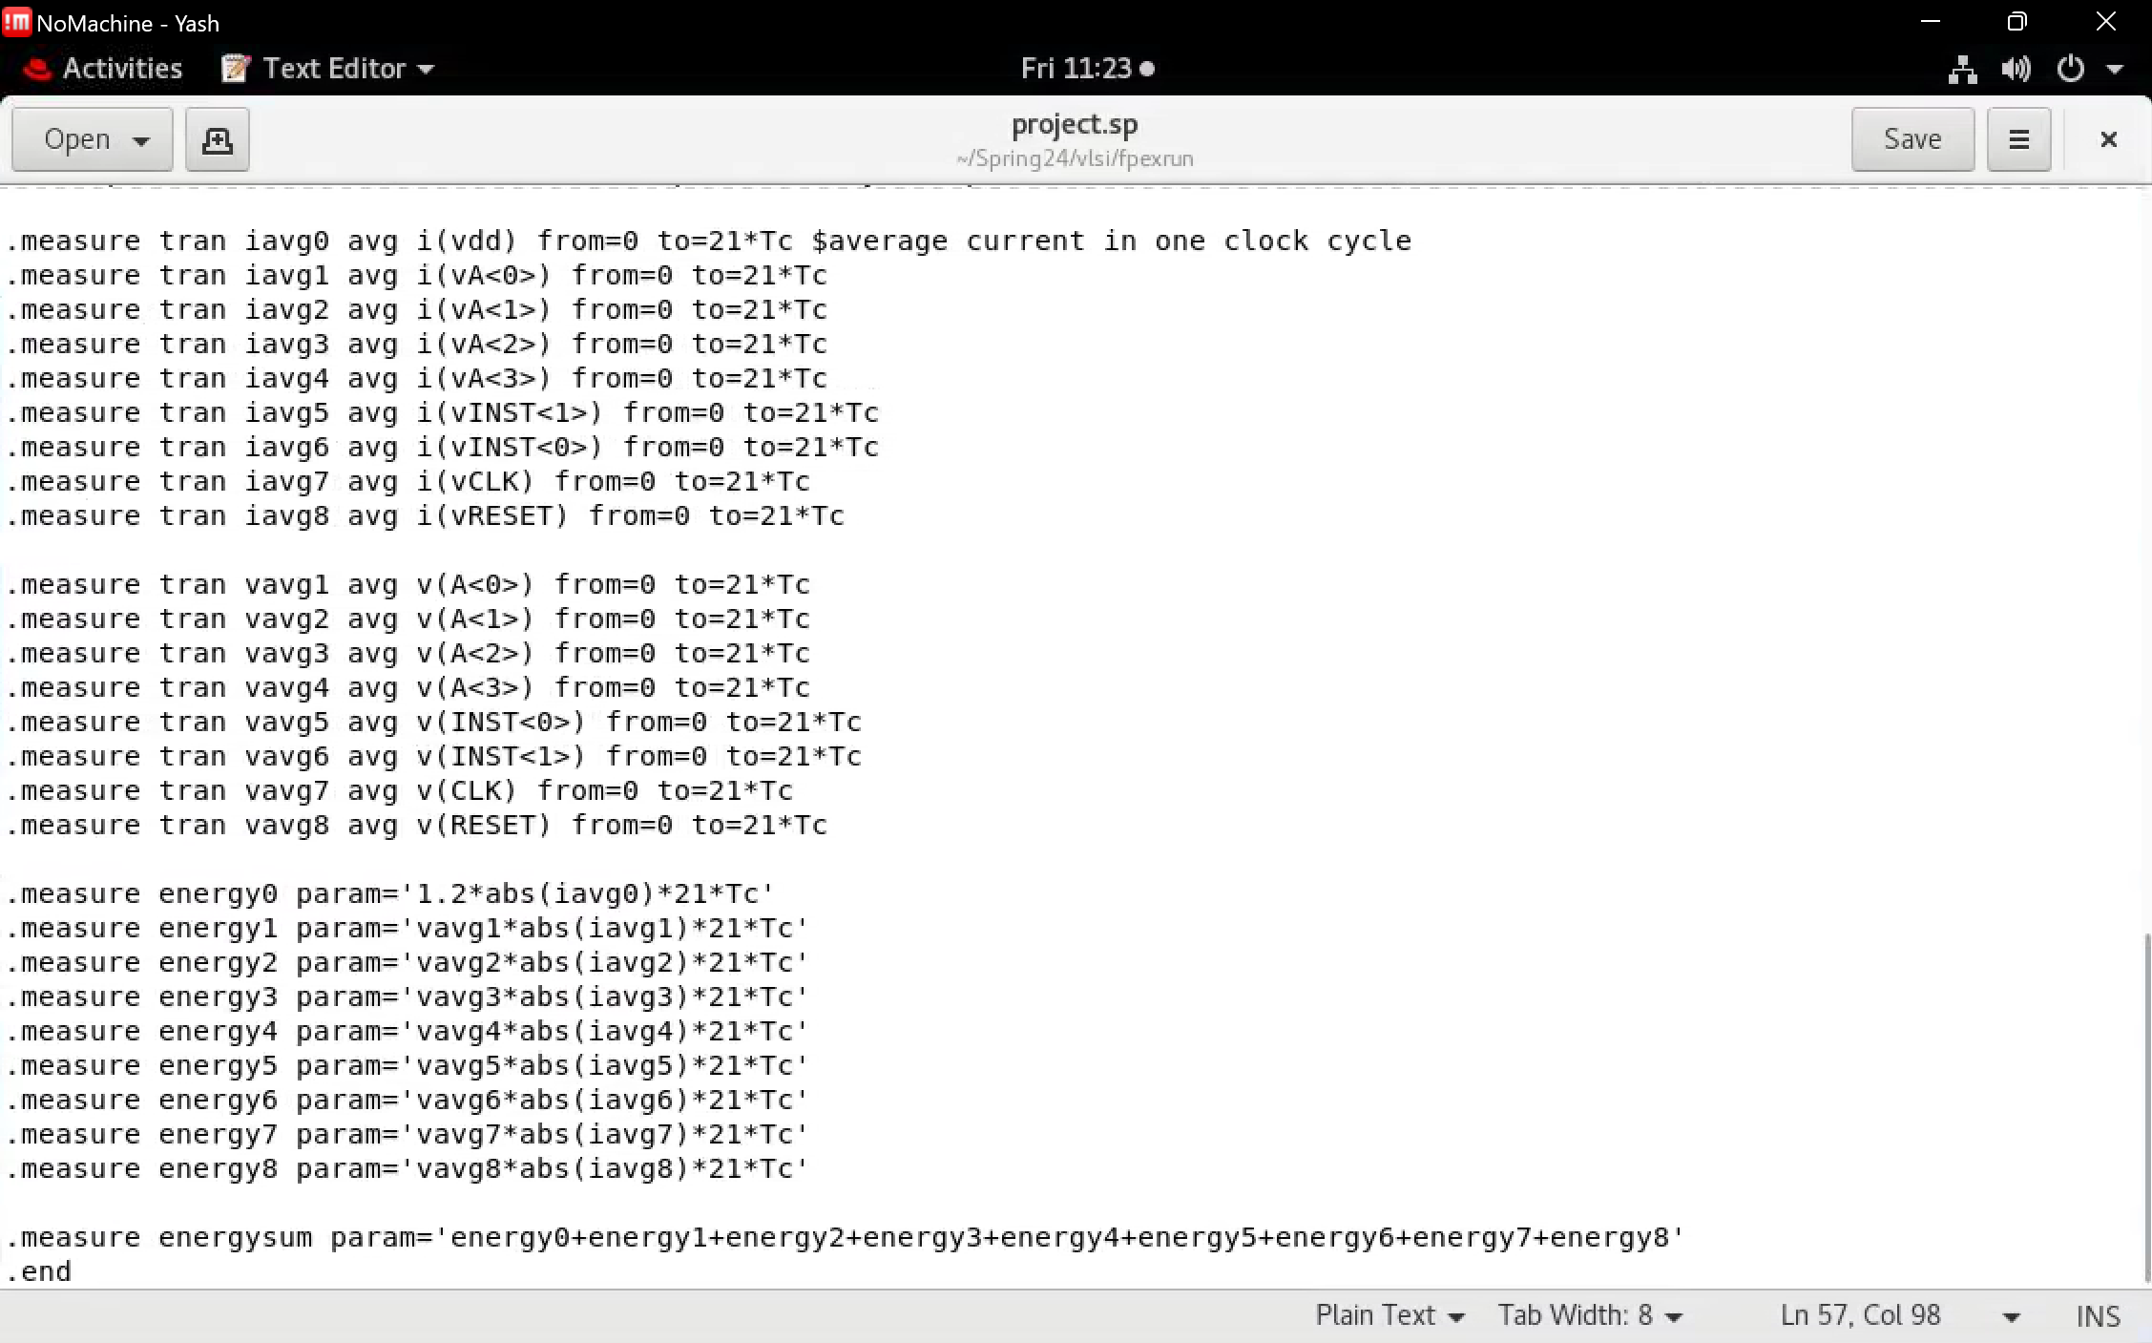

Slide 21
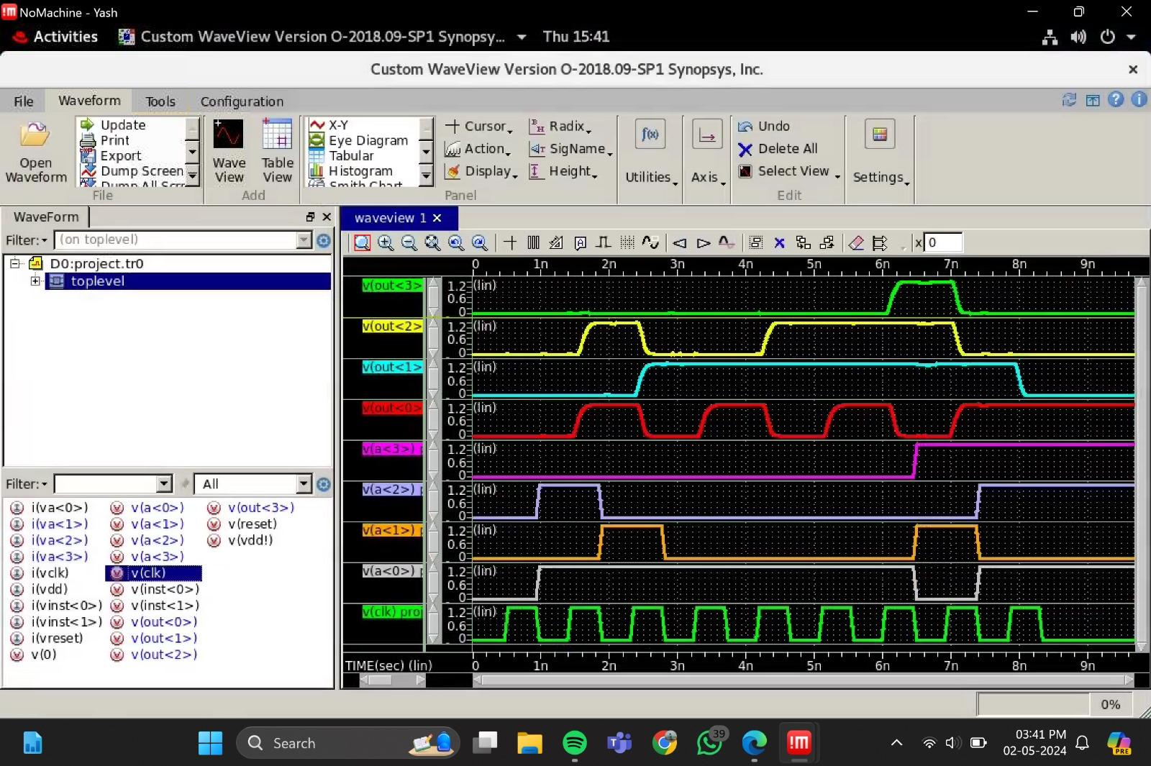
Output Waveform

Slide 22
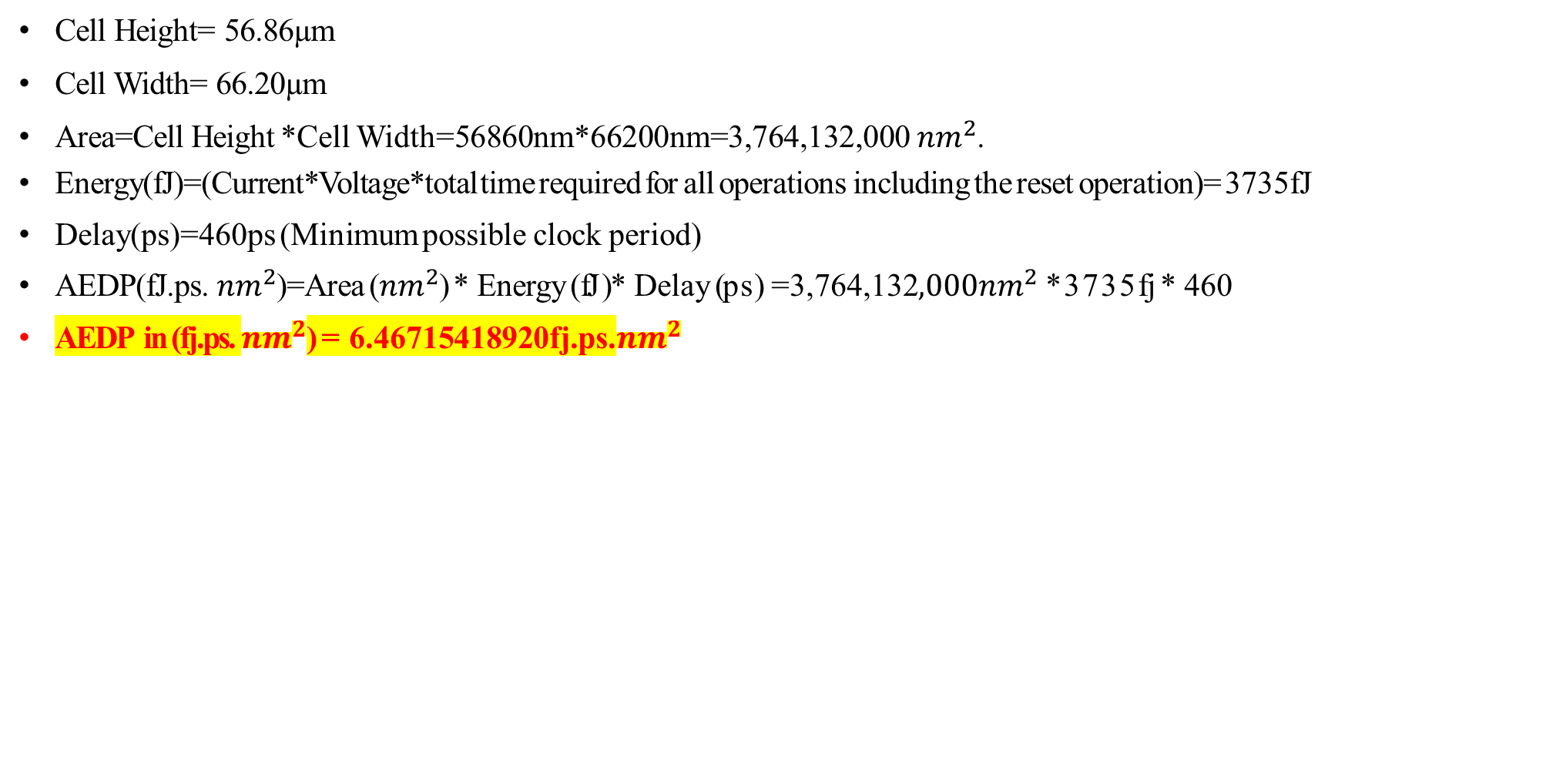
AEDP Calculation:
Cell Height= 56.86µm
Cell Width= 66.20µm
Area=Cell Height *Cell Width=56860nm*66200nm=3,764,132,000 ${nm}^{2}$.
Energy(fJ)=(Current*Voltage*total time required for all operations including the reset operation)= 3735fJ
Delay(ps)=460ps (Minimum possible clock period)
AEDP(fJ.ps. ${nm}^{2}$)=Area (${nm}^{2}$) * Energy (fJ )* Delay (ps) =3,764,132${,000nm}^{2}$*3735fj * 460
AEDP in (fj.ps. ${nm}^{2}$) = 6.46715418920fj.ps.${nm}^{2}$

Slide 23

Thank You

